Slide 1
United Airlines Call Center Optimization
AHT and AST Analysis

Slide 2
Problem Statement
Overview: Briefly state the problem United Airlines faces with high Average Handle Time (AHT) and Average Speed to Answer (AST) in their call center.
Challenges: Discuss how these inefficiencies affect customer satisfaction and operational costs.
Delays in answering customer calls.
Prolonged conversations reducing efficiency.
Impact on customer experience.
Objectives
Goal: Reducing AHT and AST.
Improving customer experience.
Streamlining call center operations.
Mention any additional objectives like enhancing self-service through
Interactive Voice Response (IVR).
9 October 2024
2

Slide 3
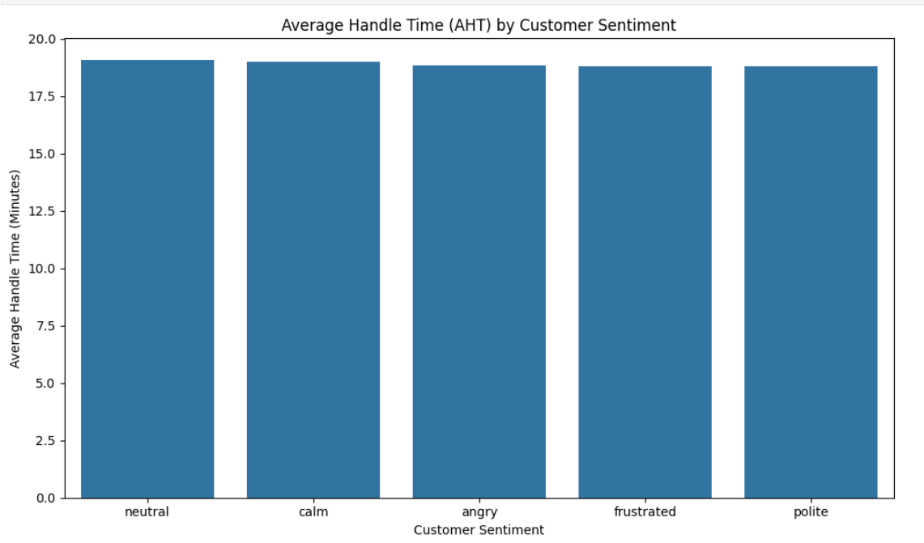
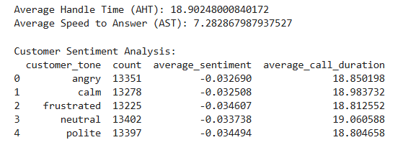
Feature Engineering
New Features Created:Call Duration: Time spent on each call.
Wait Time: Time before an agent answers.
Sentiment-Based Features: Scores extracted from call transcripts reflecting customer tone.
9 October 2024
3

Slide 4
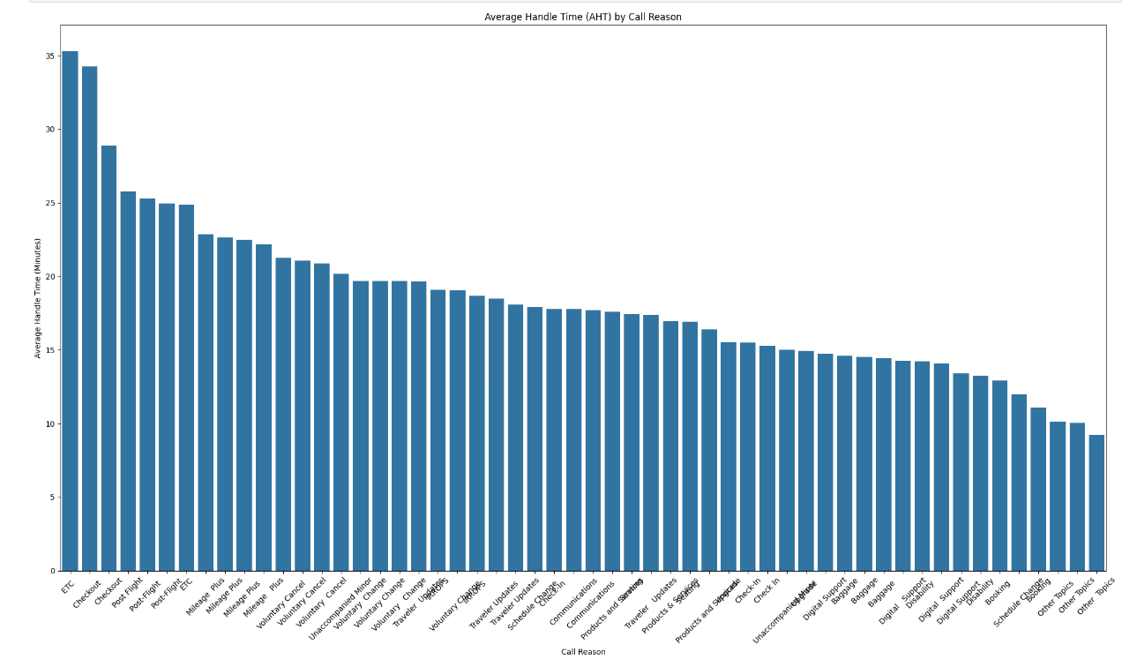
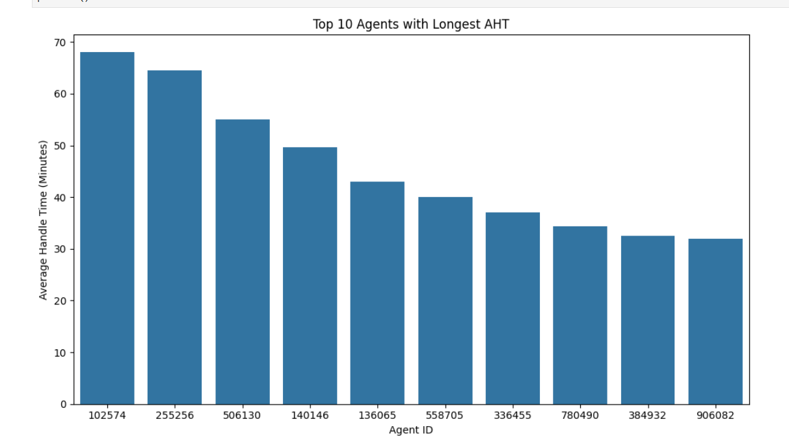
AHT Analysis
9 October 2024
4

Slide 5
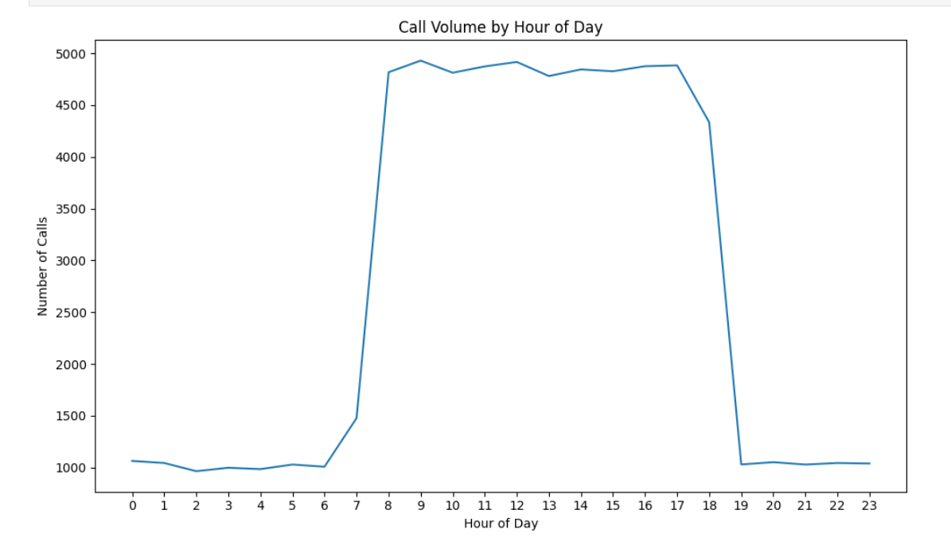
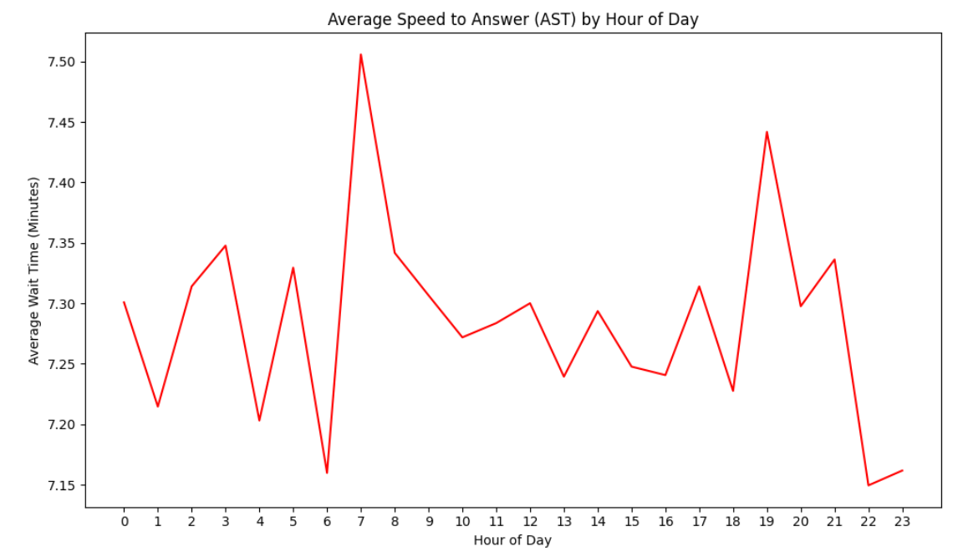
AST Analysis
Highlight any information/references that would help to understand the problem/solution better.
Any architecture to explain the Solution’s feasibility can add value
9 October 2024
9 October 2024
5

Slide 6
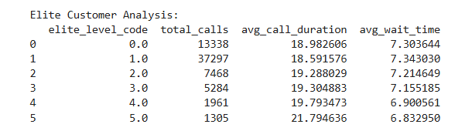
Recommendations
Staffing Adjustments: Increase staffing during peak hours to reduce AST.
Self-Service Optimization: Automate frequent call types like seating and booking changes through IVR.
Agent Training: Provide training for agents to handle frustrated and angry customers more effectively.
Improved Call Routing: Use sentiment analysis and call reason prediction to better route calls to specialized agents.
9 October 2024
6

